Slide 1
Summer training project report
MY FEEDBACK SYSTEM
Presented By:
ARJUMAND NISSAR
Btech CSE 5th semester
1704059

Slide 2
Contents
Introduction to training institute.
Introduction to project
Objectives of project
Why this project
Modules of project
Highlights of project
Module features
Operational structure
Background information
Requirement specifications
Project layout
Conclusions and enhancements
References

Slide 3
Introduction to training institute
Alpha in K P Road, Anantnag
Alpha computer Training Institutes is one of the highly recognized training centres in this Anantnag city and was established in 2008. It has been playing a pivotal role ever since its establishment by enabling the students to have easy access to rich learning programs. It has been constantly empowering the students by helping them identify the uniqueness of their courses and curriculum while at the same time making them understand as to how to use these courses to their best advantage.
Services Offered:
Alpha enjoys a good infrastructure. The facility is endowed with a conducive learning and knowledge sharing environment. Students have convenient access to essential learning tools and study materials. The faculty team is very approachable; always keen to help and support whenever a student needs that. Each of them is very passionate about teaching and mentoring.

Slide 4
One can get various trainings related to compuer science and IT’s like: PHP HTML JAVA PYTHON .NET CLOUD COMPUTING LINUX NETWORKING C++ Why should you choose to get the industrial training at Alpha Computers? i) Deliver best training in various courses such as PHP, Java, etc. Ii) Keep you updated about all the latest inventions and technologies. Iii) Conduct doubt clearing sessions to leave no space for any sort of doubt in the student. Iv) Faculties are the working professionals and experienced in their field. V) Make students familiar with the real working environment. Vi) Focus on Practical works more than memorizing theories

Slide 5
Introduction to project
My Feedback System for college students have been developed which aims to rate and analyse the college faculty’s performance.
This type of Student Feedback system reduces, the strenuous work of physically examining the feedback pages of each and every student.
The system also reduces the burden of efforts and burden of keeping and maintaining the records on a manual base, it requires a lot of space and safety to keep up such records.
Also the students feedbacks can be tempered for wrong reasons in case of paper based feedbacks wherein the MFS will always ensure safety of feedbacks privacy.
Another important features of the MFS is that physical presence of neither the admin nor the student is required for the either giving the feedback nor for assessing the feedback.
Also further enhancement can be done and more features can be added for better retrieval of the feedback details.

Slide 6
Objectives of project
1) Decision making power is provided by this system.
2) Accurate result can be obtained.
3) This system makes Selection process more effective
4) To increase efficiency proposed system is depend on classification method.
5) Proposed system is used to reduce confusion at the time of processing feedback.

Slide 7
WHY THIS PROJECT?
1) Saves your time:
By giving feedback on online system rather then on paper system saves our time.
2) Manage the entire process:
The entire process of giving feedback and viewing that report after giving feedback can manage easily.
3) Enhance the staff:
Find the details about the teacher’s interest in teaching to the students.
4) Meet web standards:
An easy to use system that successfully combines form with function.

Slide 8
Modules of project
The proposed system consists of three modules:
Student:
The student will have the authorities on this as following:
1) Add questions
2) Update questions
3) View questions
4) Giving feedback about the lecturers
Faculty:
The Faculty will have the authorities on this as following:
1) Add questions
2) Update questions
3) View questions
4) View report
Admin :
1) Saves your time
2) Manage the entire process in easy and quick way
3) Enhance the staff
4) Improve the issuing standards

Slide 9
Highlights of project
➢ Saves your time
➢ Manage the entire process in easy and quick way
➢ Enhance the staff
➢ Improve the issuing standards

Slide 10
Module features
Admin Features
Admin Login
Admin can add new faculty
Admin can View faculty list
Admin can Update faculty data
Admin can Delete faculty
Admin can Manage Student
Admin can Check feedback given by student
Admin can check average feedback for faculty
Admin can update the contact details dynamically
Admin can update password
Faculty Features
Faculty can login
Faculty can update their profile
Faculty can update Password
Faculty can Check feedback given by students
Faculty can check average feedback given by students
Logout

Slide 11
Student Features
Student can Register
Student can Login
Student can view profile
Student can update profile
Student can update Password
Student can choose faculty and give feedback for every Questions
Software Requirements
XAMPP server
Language Used
Front End : HTML 5 ,BOOTSTRAP
Server Language : PHP 5.5
Backe End : MYSQL

Slide 12
Operational structure
REQUIREMENT ANALYSIS PHASE:
This phase includes the identification of the problem, in order to identify the problem; we have to know information about the problem, the purpose of the evaluation for problem to be known. We have to clearly know about the client’s requirements and the objectives of the project.
SYSTEM ANALYSIS PHASE:
Feasibility analysis involves the benefits of various approaches and the determination of the alternative approaches all through methods like questionnaires and interviews etc., different data about the project are collected and the data through out the project is represented in the graphical form.
DESIGN PHASE:
The design phase leads to modules that exhibit independent functional characteristics. It even leads to an interface that reduces the complexity of the connections between modules and with the external environment. The design phase has main importance because in this activity, decisions ultimately affect the success of s/w implementation and maintenance.

Slide 13
DEVELOPMENT PHASE:
The development phase includes choosing of a suitable s/w to solve the particular problem given. The various facilities and the sophistication in the selected s/w give a better development of the problem.
CODING PHASE:
The coding phase is for translating the design of the system produced during the design phase into code in a programming language, which can be executed by a computer and which performs the computation specified by the user.
TESTING PHASE:
Testing is done in various ways such as testing the algorithm, programming code, simple data debugging is also one of the testing methodology.

Slide 14
Background information
HTML
HTML stands for Hyper Text Markup Language
Hyper text is ordinary text that has been dressed up with features such as formatting, images, multimedia and links to other documents.
Markup is the process of taking ordinary text and adding extra symbols.
An HTML file is a text file containing small markup tags
The markup tags tell the Web browser how to display the page
An HTML file must have an .htm or .html file extension
An HTML file can be created using a simple text editor
HTML Advantages:
HTML is the primary format used on the World Wide Web.
HTML can display Web pages with a wide range of colors , shapes, and objects.
HTML is so flexible, many browsers and Web applications have added their own functionality to the base HTML protocol.

Slide 15
MySQL
MySQL is a database management system.
MySQL is a relational database management system.
MySQL software is Open Source.
The MySQL Database Server is very fast, reliable, and easy to use.
MySQL Server works in client/server or embedded systems.
The Main Features of MySQL:
Written in C and C++.
Tested with a broad range of different compilers.
Works on many different platforms.
The MySQL Server design is multi-layered with independent modules.
Relatively easy to add other storage engines. This is useful if you want to provide an SQL interface for an in-house database.
A very fast thread-based memory allocation system.
In-memory hash tables, which are used as temporary tables.

Slide 16
PHP
PHP stands for PHP: Hypertext Preprocessor
PHP is a server-side scripting language, like ASP
PHP scripts are executed on the server
PHP supports many databases (MySQL, Informix, Oracle, Sybase, Solid, Generic ODBC, etc.)
PHP is an open source software (OSS)
PHP is free to download and use
PHP is a reflective programming language originally designed for producing dynamic web pages.
Features of PHP:
Robust support for object oriented programming
The php data objects extension, which defines a lightweight and consistent interface for accessing databases.
Better support for my sql through a completely rewritten extension.
Error handling through exception

Slide 17
Requirement specifications
SOFTWARE REQUIREMENTS:
Operating system : WINDOWS XP/ 7/8/10/RED HAT/LINUX
Connectivity : PHP
Data base : MYSQL
Web browser : MOZILLA or IE
Front end : HTML
Server : XAMPP
HARDWARE REQUIREMENTS:
Processor : PENTIUM-IV & above.
RAM : 256MB & above.
Hard Disk : 20GB & above.
Monitor

Slide 18
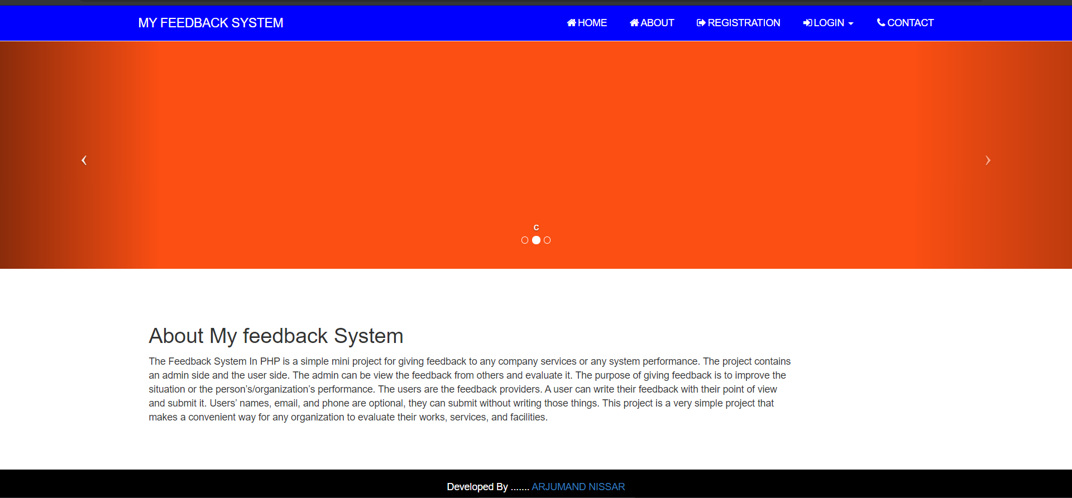
Project layout home:

Slide 19
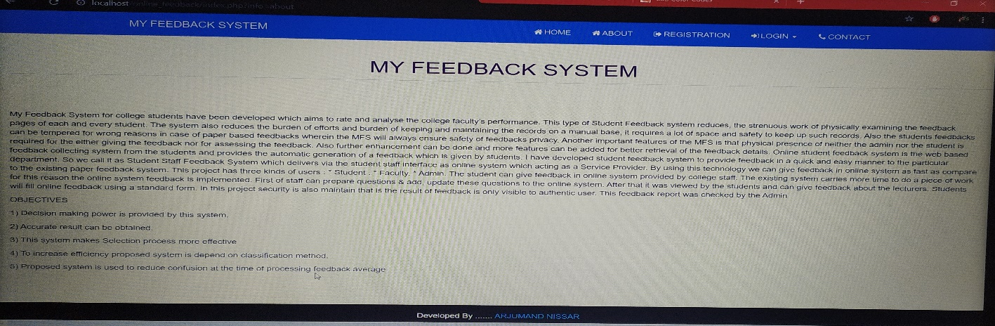
ABOUT

Slide 20
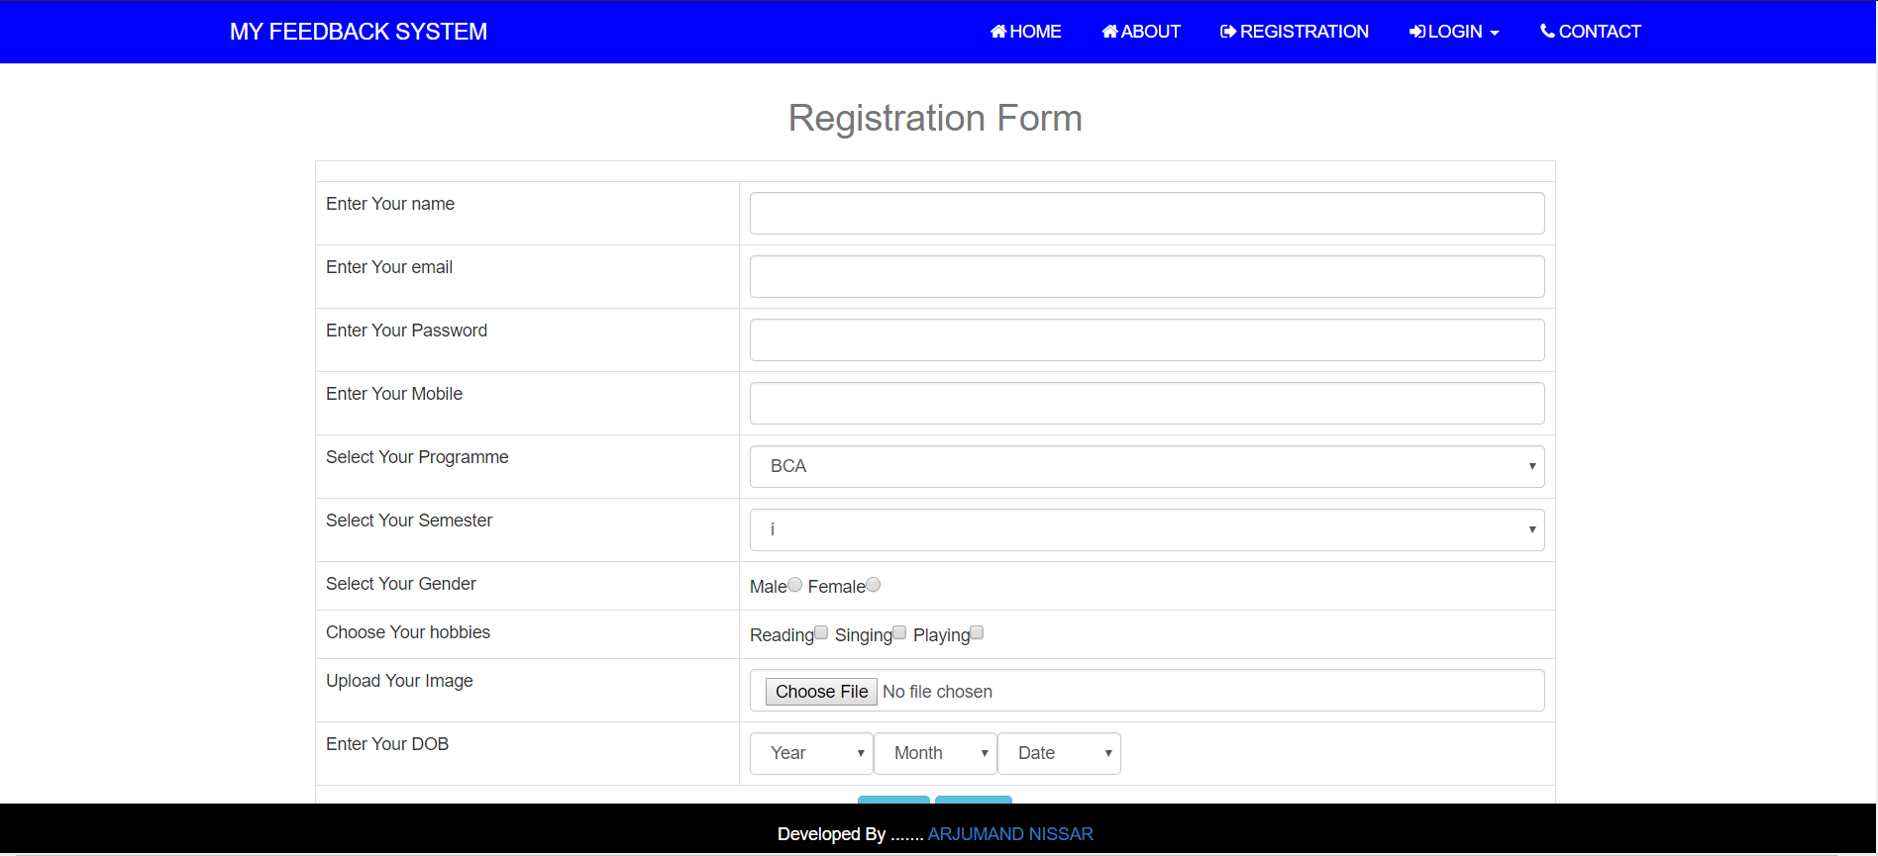
REGISTRATION

Slide 21
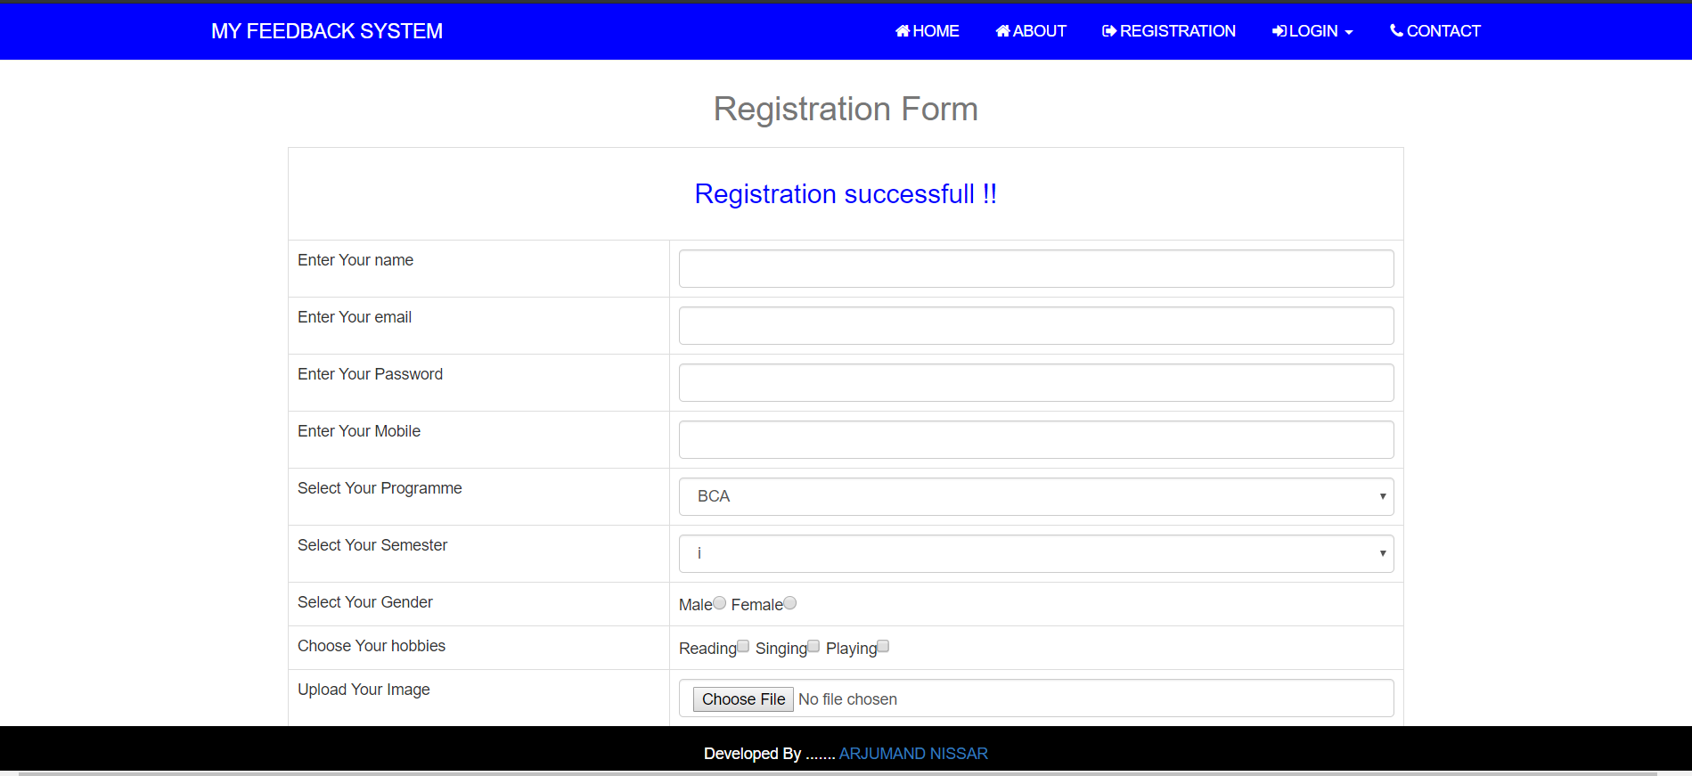
AFTER REGISTRATION

Slide 22
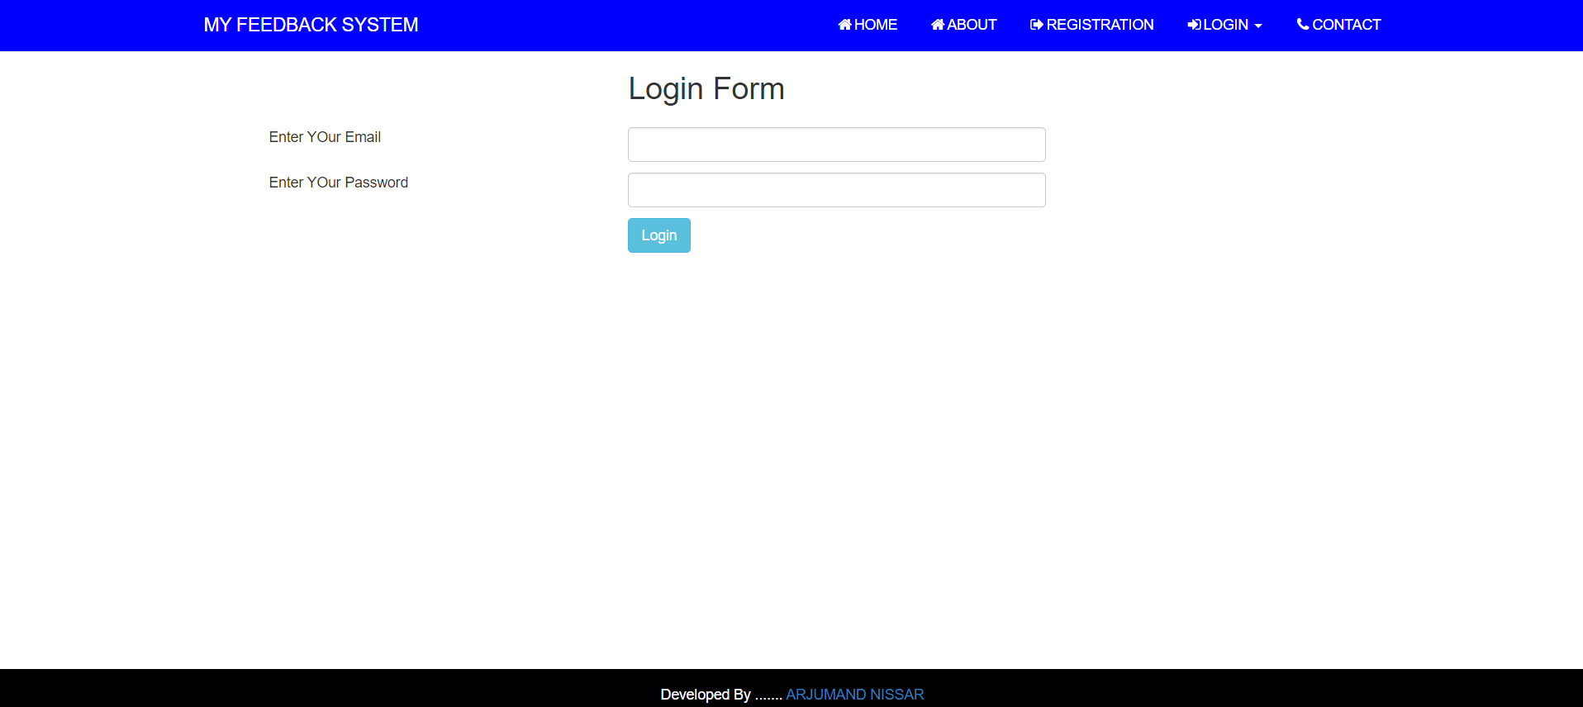
STUDENT LOGIN PAGE

Slide 23
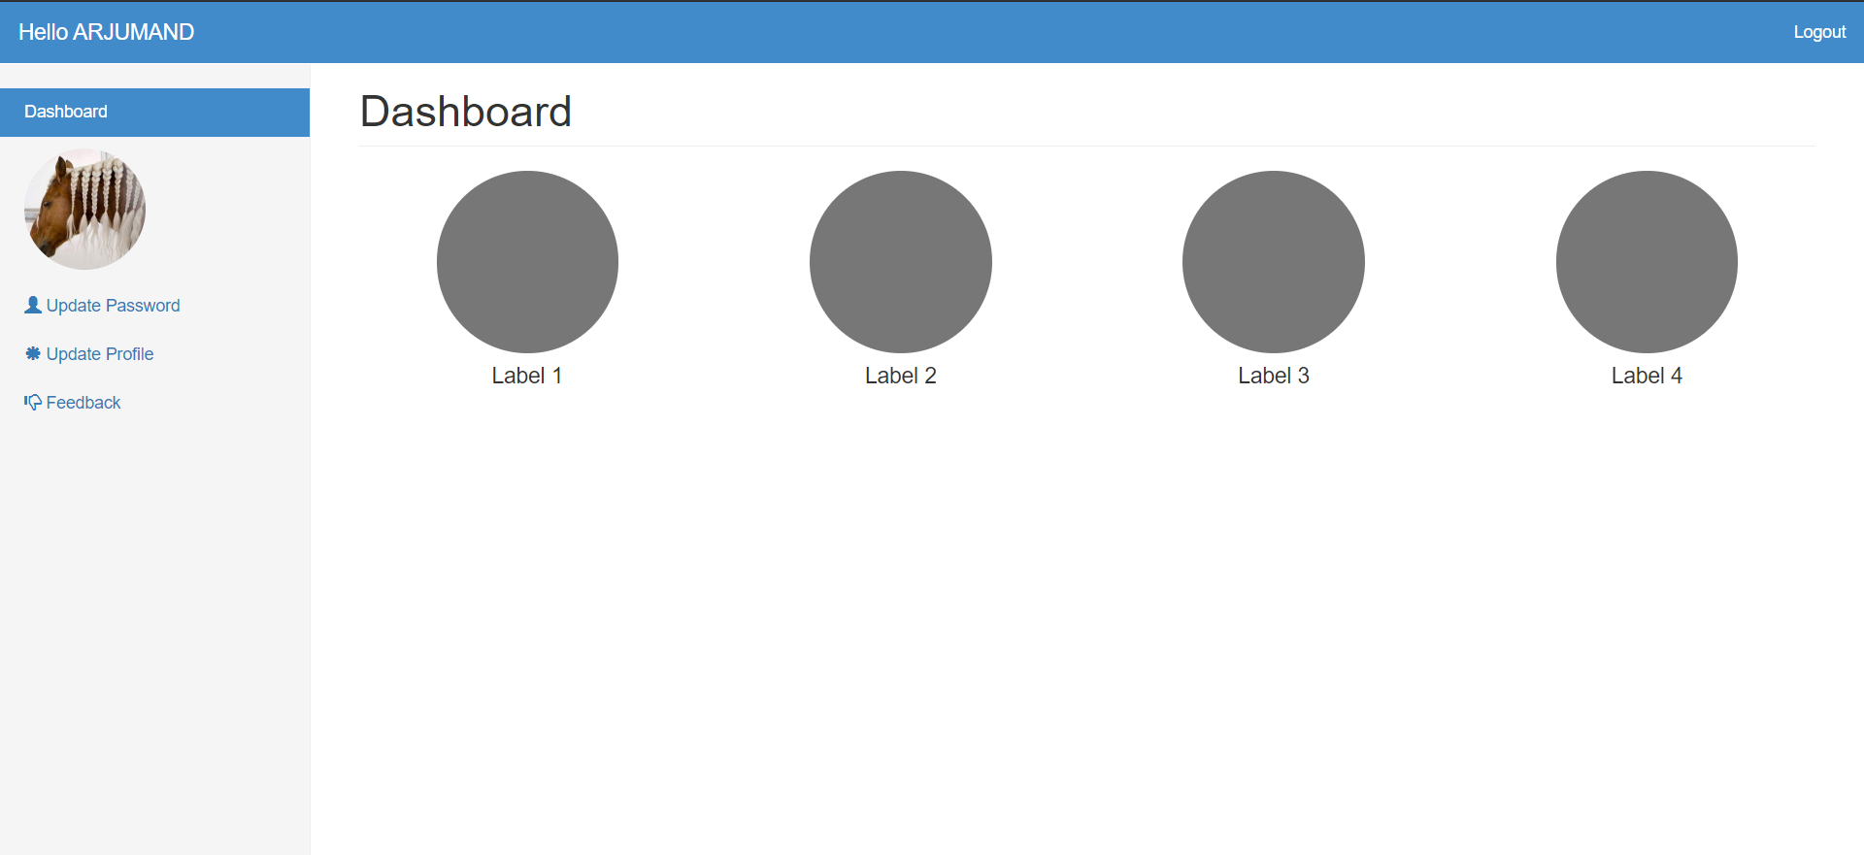
AFTER LOGIN

Slide 24
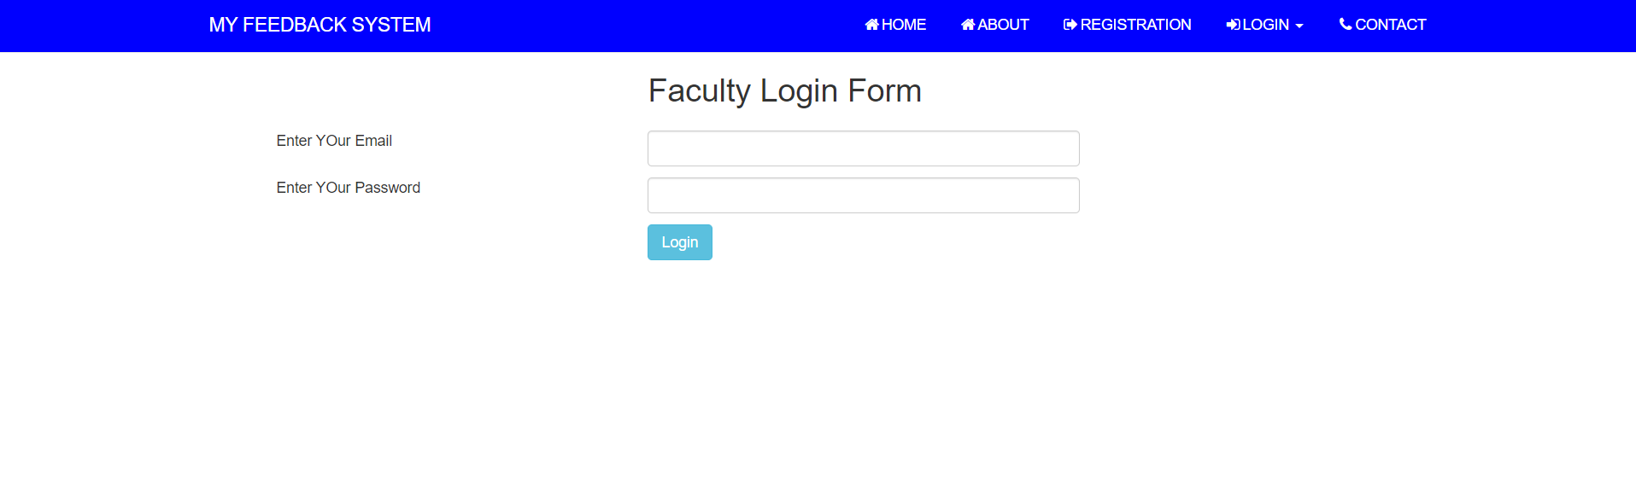
FACULTY LOGIN PAGE

Slide 25
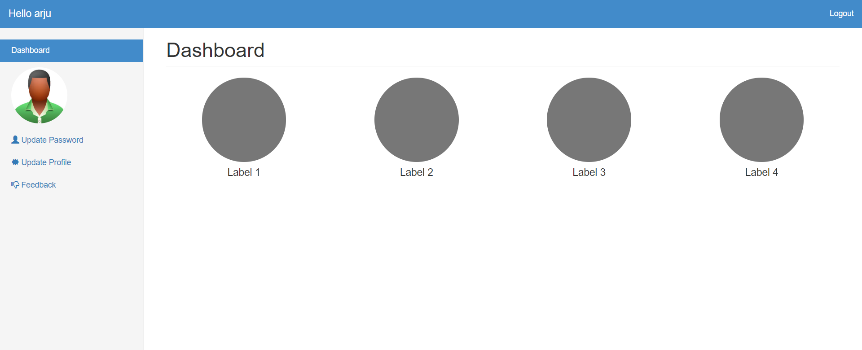
AFTER LOGIN

Slide 26
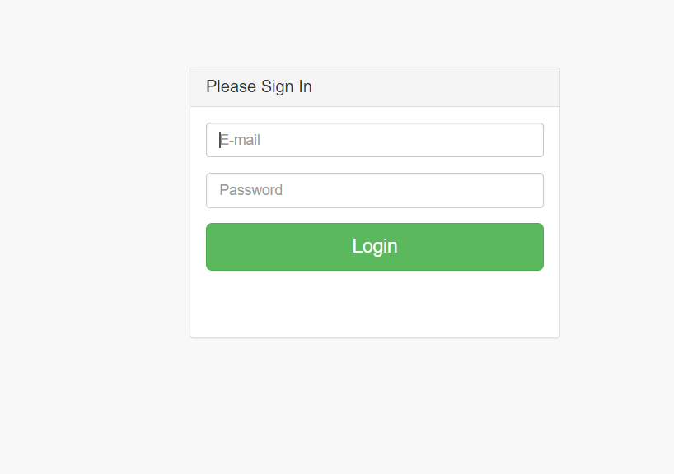
ADMIN LOGIN PAGE

Slide 27
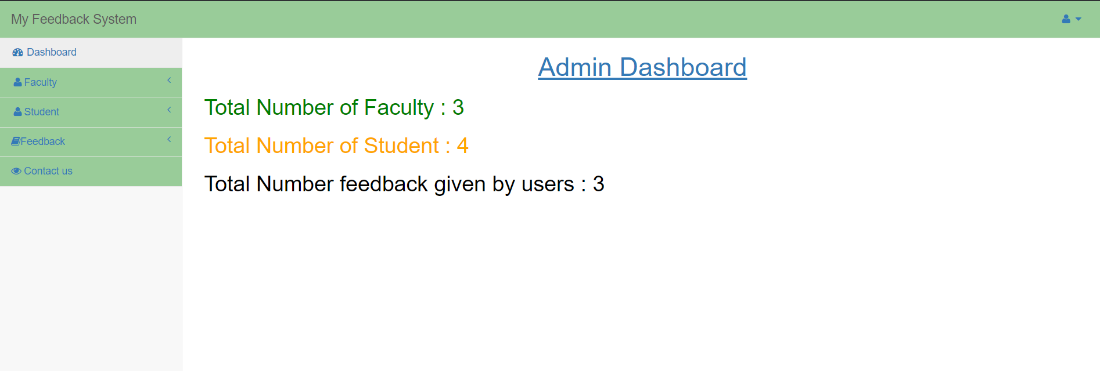
AFTER LOGIN

Slide 28
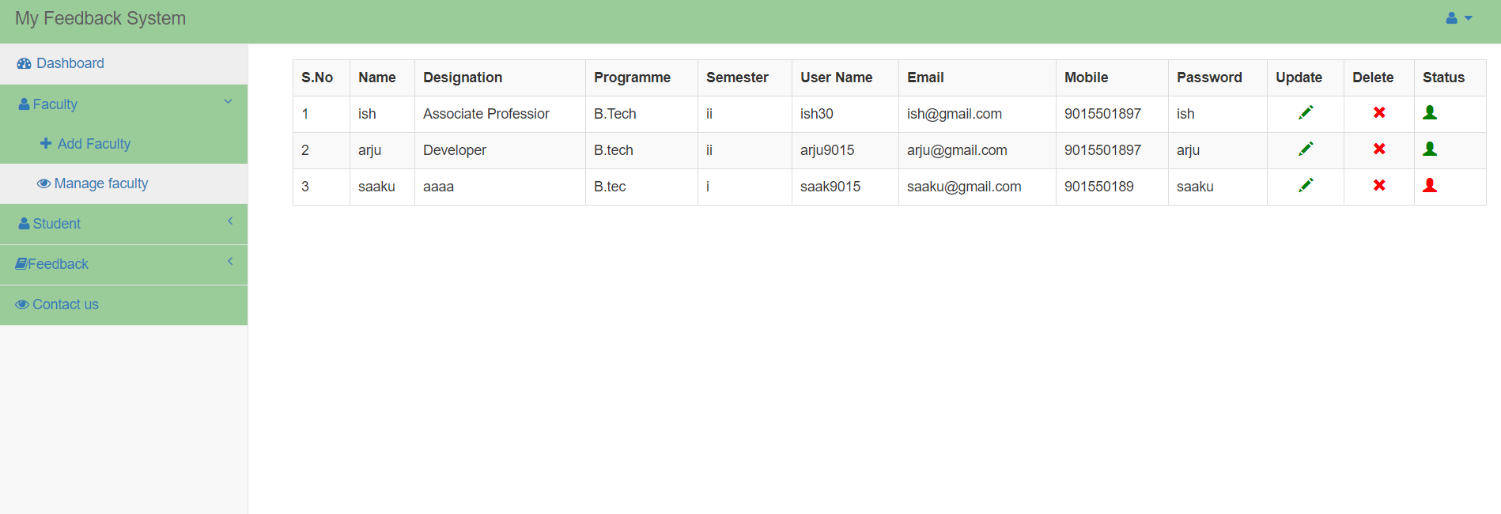
MANAGE FACULTY

Slide 29
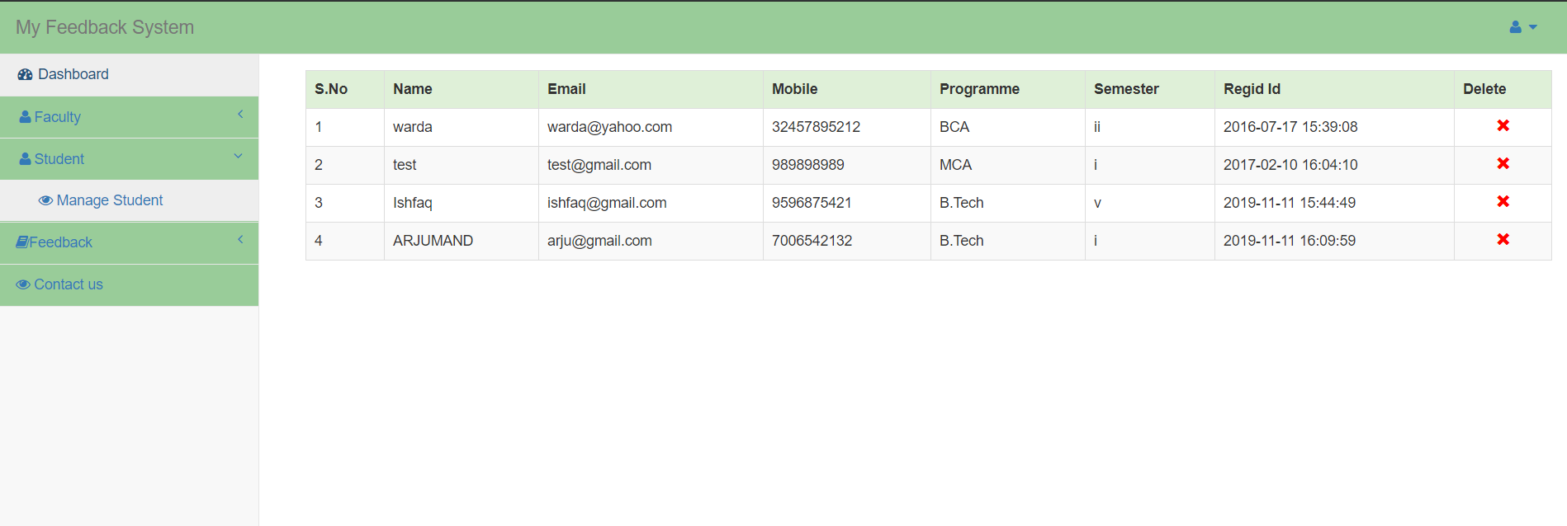
MANAGE STUDENT

Slide 30
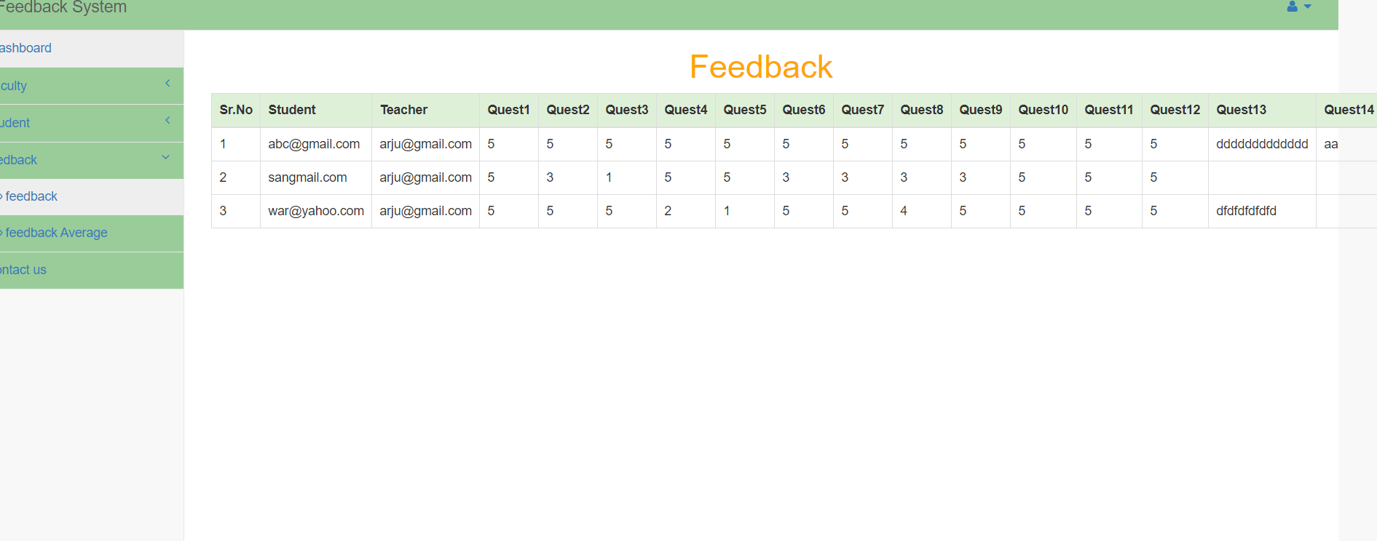
FEEDBACK

Slide 31
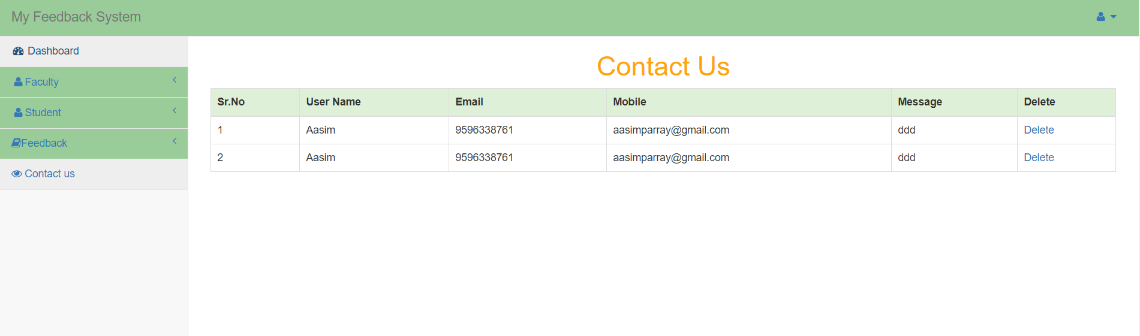
CONTACT US

Slide 32
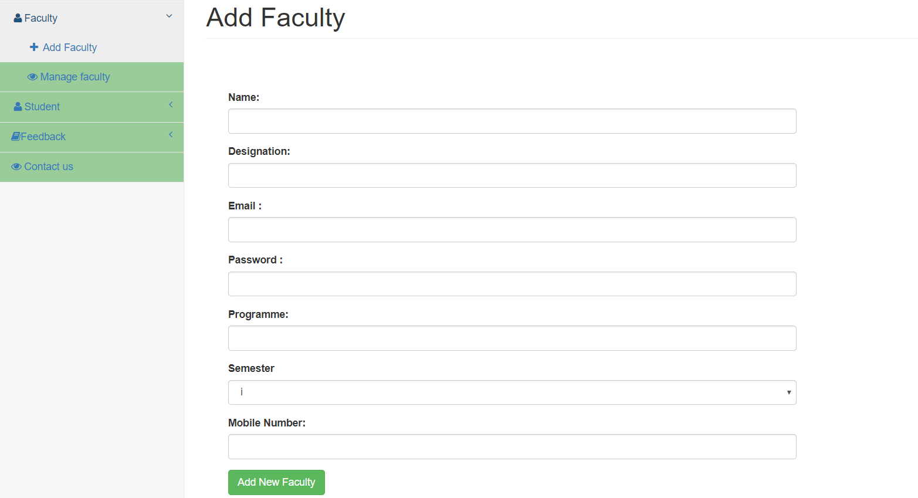
ADD FACULTY

Slide 33
CONCLUSIONS AND ENHANCEMENTS
Conclusion:
The Project “MY FEEDBACK SYSTEM” is designed in order reduce the burden of maintaining bulk of records of all the students feedback details of who study in an Educational Institution. Inserting, retrieving and updating the feedback details of a student are easy when it is compared to the manual feedback and storing. Maintaining the project is also easy which can is easily understandable. Maintaining the details in the database is manageable.
By using this system we can give feedback in online system as fast as compare to the existing paper feedback system.
In this project security is also maintained that is the result of feedback is only visible to authentic user.
Future Enhancements:
Due to the lack of time, the design part is not done so attractive. Further enhancements can be made in designing the screens. Some more forms can also be added so as to better retrieve the feedback details. Various other options can also be added for the better usability of project.

Slide 34
REFERENCES
DATABASE MANAGEMENT SYSTEMS” Raghu Rama Krishnan Gehrke, McGraw-Hill Publications 3rd edition.
PHP PROGRAMMING “Vikram Vaswani”
PHP reference manual obtained from www.php.net
HTML and PHP reference from www.w2schools.com
https://getbootstrap.com/docs/4.2/components/carousel/
https://www.geeksforgeeks.org/
www.w3schools.com/php/php_mysql_intro.asp

Slide 35
THANKS ..

